Slide 1




Introduction to Web Development
Gil Domingues

Slide 2
On the menu
Brief Introduction
HTML Basics
CSS Basics
PHP Basics
Javascript and Jquery Basics
Exercises/Questions

Slide 3
HTML

Slide 4
HTML
HTML is composed of a tree of HTML elements
Elements can contain other elements or text
HTML elements are defined by tags
Elements can have attributes
A tag starts with a < and ends with a > and always contains a name. <html>
Some tags come in pairs, an opening tag and a closing tag.
<html> content </html>
Notes:
Falar de como o linux inclui python por defeito.

Slide 5
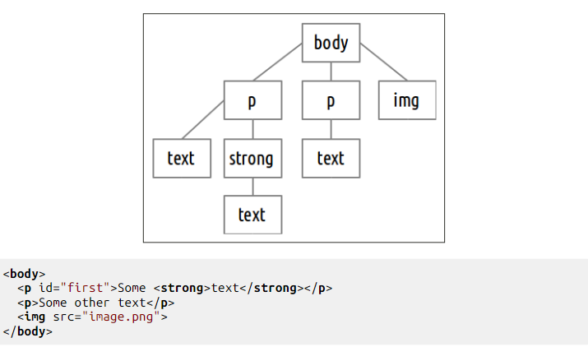
HTML
HTML elements can have children. Those elements have an opening and an ending tag.
Notes:
Falar de como o linux inclui python por defeito.

Slide 6
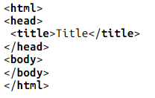
HTML
Basic HTML file structure
Outer html tag
Head and body as children of the html tag
Head tag must contain title
Notes:
Falar de como o linux inclui python por defeito.

Slide 7
HTML
Common HTML tags
<h1></h1>…<h6></h6> - Headings
<p></p> - Paragraphs
<br> - Line Break
<a href=“…”></a> - Anchor
<img src=“…”> - Image
Notes:
Falar de como o linux inclui python por defeito.

Slide 8
HTML
Lists
<ul></ul> - Unordered list
<ol></ol> - Ordered list
<li></li> - List item
Notes:
Falar de como o linux inclui python por defeito.

Slide 9
HTML
Forms
<form action=“url_to_action.php” method=“get|post|…”>…..</form>
<input type=“text|password|email|…” name=“…”>
Other input attributes:
Placeholder
Autocomplete
Readonly
Required
Disabled
Notes:
Falar de como o linux inclui python por defeito.

Slide 10
HTML
File upload
<input type="file" name="file">
Form must have attribute enctype=“multipart/form-data”
Submit
<input type=“submit” value=“send”>
Notes:
Falar de como o linux inclui python por defeito.

Slide 11
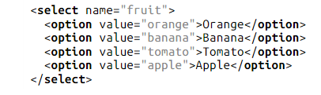
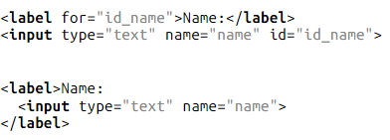
HTML
Select
Dropdown boxes
Label
Allows associating a label with a input field
Notes:
Falar de como o linux inclui python por defeito.

Slide 12
HTML
Element Display
Elements can be divided into inline and block elements.
Inline elements ocuppy the space they require and don’t force line breaks
Block elements use all the horizontal space by default and force a line break
Notes:
Falar de como o linux inclui python por defeito.

Slide 13
HTML
ID’s and Classes
Attributes used to easily identify elements.
ID is an unique identifier of a specific element
Multiple elements can have a common class
Notes:
Falar de como o linux inclui python por defeito.

Slide 14
HTML
Generic Tags
Tags that have no meaning other than provide structure
Span: generic inline tag (mark specific parts of text)
Div: generic block tag (define sections of a website)
Notes:
Falar de como o linux inclui python por defeito.

Slide 15

HTML
Document Type
HTML 5
Informs the browser of what HTML version you are using.
Must be the first thing in your document.
Notes:
Falar de como o linux inclui python por defeito.

Slide 16
CSS
Based on two main concepts:
Selectors
Properties

Slide 17
Let’s get to work!

Slide 18
CSS

Slide 19
CSS
Selectors
Allow the selection of the desired html element(s) to which we want to apply some styles

Slide 20
CSS
Properties
Defines which aspect of the selected element will be modified

Slide 21
CSS
Linking CSS file to HTML
Inside the head tag

Slide 22
CSS
Selectors
By elemento type: element
By id: #id
By class: .class
Descendants: elemento descentant_elemento
All elements: *

Slide 23
CSS
Common properties
Font color: color
Background color: background-color
Width/height: width/height
Font family: font-family
Font weight: font-weight
Font size: font-size
Font style: font-style
Horizontal text alignment: text-align
Display property: display Values: inline, block, inline-block and none
Margin: margin(-[top|bottom|left|right])
Padding: padding(-[top|bottom|left|right])
Border: border(-[top|bottom|left|right])
Border (style/width/color): border-(style|width|color)
Position: position Values: static, relative, absolute and fixed.

Slide 24
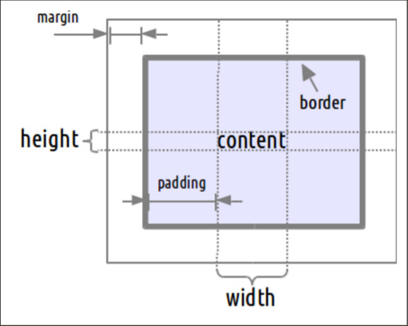
CSS
Margin, padding and border

Slide 25
PHP

Slide 26
PHP
PHP is a server-side scripting language which allows the processing of the user’s request and providing a response page
Code block delimiters <?php ………. ?>
Each php code block is interpreted and its output is printed

Slide 27
PHP
Echo
Echo is a language construct that prints strings
<?php echo ‘Hello World’; ?>
Short version of a delimiter for echo <?=‘Hello World’?>

Slide 28

PHP
Variables
Variables in php are represented by a dollar sign followed by the name of the variable
A variable type is defined by the context in which the variable is used

Slide 29
PHP
Assignment
The type of a variable changes with the type of value attributed to it
Assignment is done by value unless the & sign is used

Slide 30
PHP
Control structures
Php has the common control structures: while loops, for loops, if..else, break, continue, switch, die/exit.

Slide 31
PHP
Loose and Strict comparators
Loose comparator $a == $b
Strict comparator $a === $b
A loose comparator casts one of the variables to the type of the other in order to compare them
A strict comparator takes into account the variable type. Therefore, a strict comparison is only true if the variables are equal and of the same type

Slide 32
PHP
String concatenation
echo $stringOne . $stringTwo
Attention: in php the ‘+’ is reserved for arithmetic operations
Other string functions
strlen(), strops(), substr(), str_replace(), explode(), implode(),

Slide 33
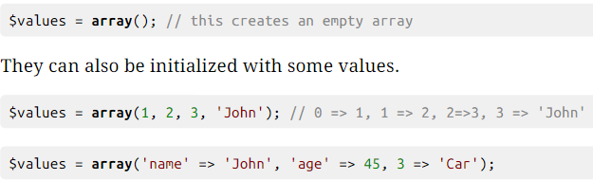
PHP
Arrays
Array is an ordered map organized as an ordered collection of key-value pairs
Keys can be either strings or integers, and an array can hold multiple types of data

Slide 34
PHP
Cycling arrays
As arrays may not have sequential keys, we can use the following construct to cycle through them:
foreach( $array as $value){
echo $value;

Slide 35
PHP
Array functions
in_array(), array_search(), array_key_exists(), asort(), ksort(), shuffle(), array_rand(), list()

Slide 36
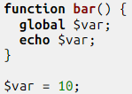
PHP
Functions
Functions in PHP accept default values in their definition
Functions can receive arguments by value or by reference (preceded with a &)
To use a global variable inside a function we have to declare it as global

Slide 37
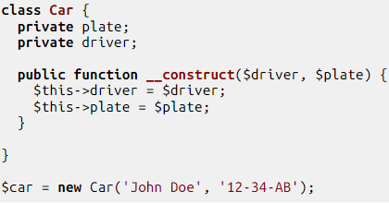
PHP
Classes
PHP supports the creation of classes since version 5
A class can have properties and methods

Slide 38
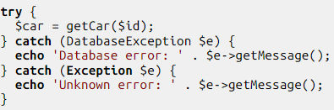
PHP
Exceptions and handling them
To handle a possible exception, one must use a try/catch set of blocks

Slide 39
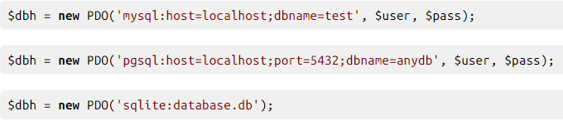
PHP
Databases
PHP data objects (PDO) is an interface used to access databases.
Connection

Slide 40
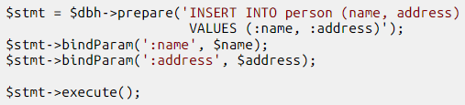
PHP
Databases – Prepared statements
Fetching Results
fetch function returns one row at a time
fetch_all function returns an array of rows

Slide 41
PHP
HTTP Parameters
$_GET is an associative array of variables passed to the current script via the URL parameters
$_POST is an associative array of variables passed to the current script via HTTP Header

Slide 42
PHP
Sessions
Sessions can be started by using the following function (note: this function must be called before any output from your script)
The special $_SESSION variable is an associative array containing session variables available to the current script
Sessions can also be destroyed to clear any information stored in the $_SESSION variable

Slide 43
PHP
Includes
The include statement includes and evaluates a given file
The required statement is identical to include but in case of failure it will produce a fatal error
The include_once statement is identical to include but PHP will check if the file has already been included
The require_once statement is identical to require but PHP will check if the file has already been included

Slide 44
PHP
JSON
There are functions to encode and decode json easily

Slide 45
Let’s get to work!

Slide 46
PHP

Slide 47
Javascript
Including javascript in a html page
<script src=“where/the/script/is.js”></script>

Slide 48

Javascript
Variables
Loosely typed language, every variable is declared as a var, not as the type of variable it is.

Slide 49
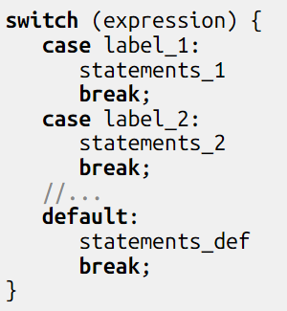
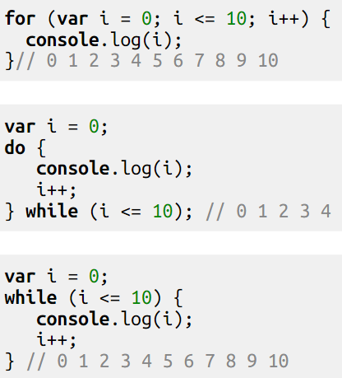
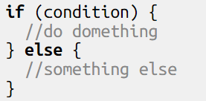
Javascript
Control Structures

Slide 50
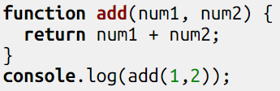
Javascript
Functions

Slide 51

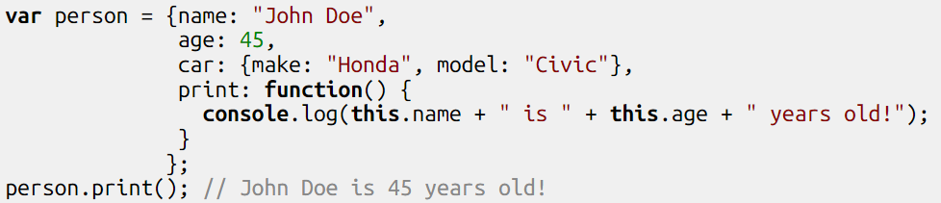
Javascript
Objects
Objects are a collection of properties
A property can be a function (called method)
Can be considered associative arrays

Slide 52
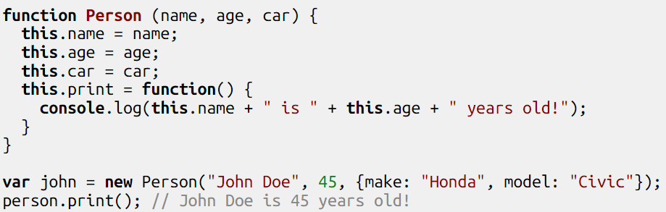
Javascript
Constructor functions
Can be used to create new objects using the new keyword
Note: Functions are also objects

Slide 53
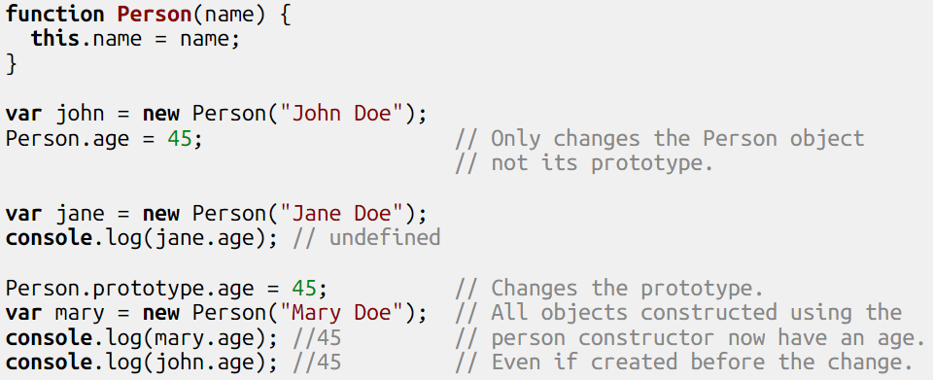
Javascript
Prototype
When the new operator is used on a constructor function, a new object is created that has the same prototype as the constructor function.

Slide 54
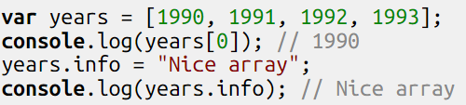
Javascript
Arrays
List-like objects whose prototypes have methods to perform traversal and mutation operations.

Slide 55
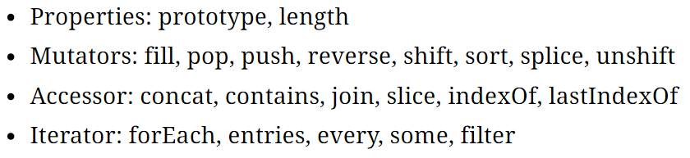
Javascript
Array prototype methods

Slide 56
JQuery
Javascript library that simplifies interaction with the DOM
Document traversal and manipulation
Event handling
Animation
Ajax
Browser compatibility

Slide 57
JQuery
Most of JQuery’s functionality is based on the use of a function/object called jQuery
Because javascript is awesome, this function can also be called $
This function returns a collection of matched elements:
Found in the DOM
Based on passed arguments
Created by passing an HTML string

Slide 58
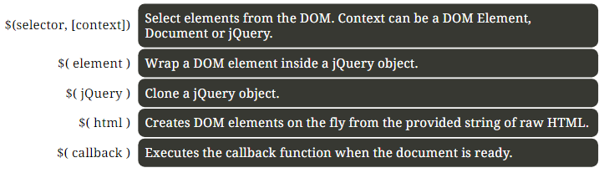
JQuery
jQuery() or $()

Slide 59

JQuery
Using JQuery
You need to import the library either by using a local version or a CDN
<script src="http://code.jquery.com/jquery-1.11.3.min.js"></script>
Before using jQuery you must wait for the document to finish loading

Slide 60
JQuery
Selectors
jQuery uses the same selectors as CSS, plus some other non-standard selectors, for example, selectors based on element attributes
Traversal
It is easy to traverse the DOM tree using functions of the jQuery object, such as: children, find, siblings, next, nextAll, parent and parents

Slide 61
jQuery
Element manipulation
Class manipulation: addClass, removeClass, hasClass, toggleClass
Attribute manipulation: attr, removeAttr, prop (for boolean attributes)
CSS manipulation: css

Slide 62
JQuery
DOM tree manipulation
Simple manipulation: empty, remove, before, prepend, after, append, replaceWith
Wrapping and unwrapping: wrap, unwrap

Slide 63
jQuery
Content
Inputs, selects and text areas: val
Text: html, text

Slide 64

jQuery
Events
Common events
Click, keypress, on, etc.

Slide 65
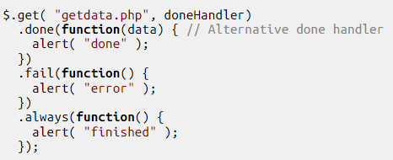
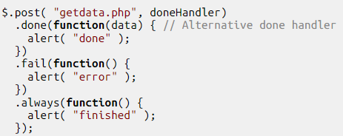
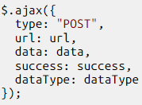
jQuery
Ajax GET

Slide 66
jQuery
Ajax POST
Different notation
Also works for get

Slide 67
Questions?

